Slide 1
Quiz ATMS 401/601

Slide 2
Equation of State for an Ideal Gas: Air
molecule size is ignorable.
molecules don’t interact (attract or repel each other).
molecular collisions are like hard point like spheres.
V = volume
Most primitive, intuitive form of the
I.G.L. (ideal gas law):
PV = NkT
P = pressure
N = # molecules
T = absolute temperature (Kelvin)
k = Boltzmann’s constant = 1.38 x 10⁻²³ Joules / (molecule K)

Slide 3

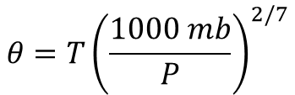
For an adiabatic process,
$${\text{P} V}^{γ}=constant where γ=\frac{c_{p}}{c_{v}}$$
Show that:
$$θ=T{\left(\frac{1000 mb}{P}\right)}^{2/7}$$
where θ is the temperature of the gas when its pressure is 1000 mb.

Slide 4
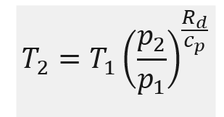
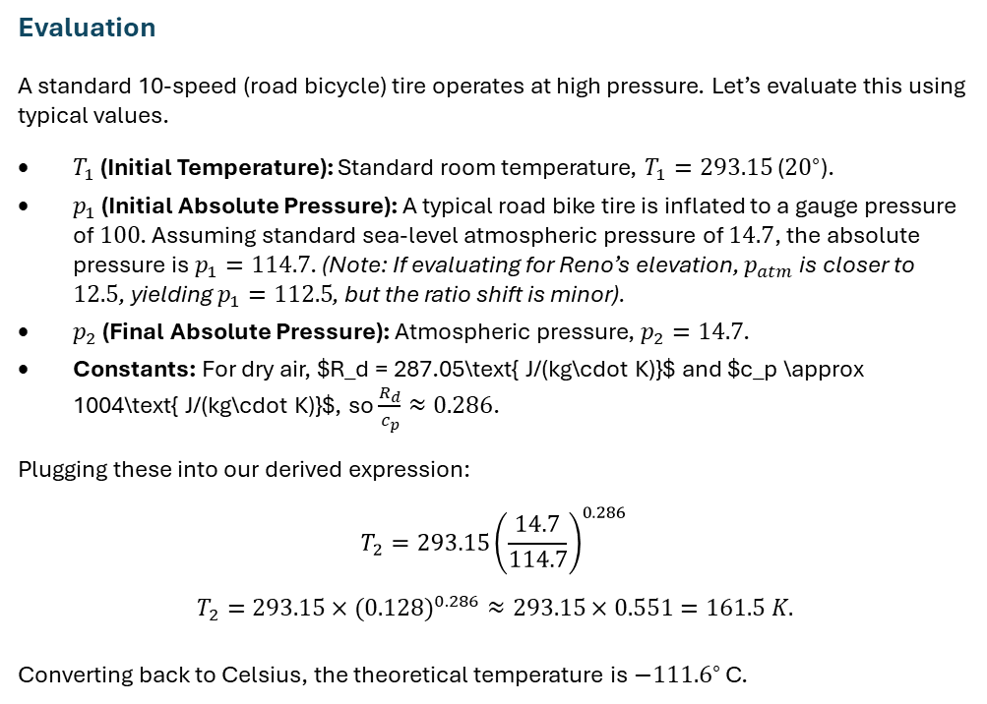
Derive an expression and evaluate the temperature of the air coming out of a 10 speed bicycle tire. Describe all assumptions.
Evaluation
A standard 10-speed (road bicycle) tire operates at high pressure. Let’s evaluate this using typical values.
$T_{1}$ (Initial Temperature): Standard room temperature, $T_{1}=293.15$ (${20}^{∘}$).
$p_{1}$ (Initial Absolute Pressure): A typical road bike tire is inflated to a gauge pressure of $100$. Assuming standard sea-level atmospheric pressure of $14.7$, the absolute pressure is $p_{1}=114.7$. (Note: If evaluating for Reno’s elevation, $p_{atm}$ is closer to $12.5$, yielding $p_{1}=112.5$, but the ratio shift is minor).
$p_{2}$ (Final Absolute Pressure): Atmospheric pressure, $p_{2}=14.7$.
Constants: For dry air, $R_d = 287.05\text{ J/(kg\cdot K)}$ and $c_p \approx 1004\text{ J/(kg\cdot K)}$, so $\frac{R_{d}}{c_{p}}≈0.286$.
Plugging these into our derived expression:
$$T_{2}=293.15{\left(\frac{14.7}{114.7}\right)}^{0.286}$$
$$T_{2}=293.15×(0.128)^{0.286}≈293.15×0.551=161.5 K.$$
Converting back to Celsius, the theoretical temperature is $−{111.6}^{∘}$ C.

Slide 5
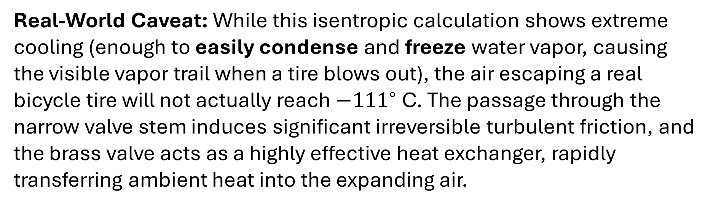
Real-World Caveat: While this isentropic calculation shows extreme cooling (enough to easily condense and freeze water vapor, causing the visible vapor trail when a tire blows out), the air escaping a real bicycle tire will not actually reach $−{111}^{∘}$ C. The passage through the narrow valve stem induces significant irreversible turbulent friction, and the brass valve acts as a highly effective heat exchanger, rapidly transferring ambient heat into the expanding air.

